Slide 1
Picture This: Best Practices in Data Visualization
Presenter: Jamison Crawford, MPA
Institutional Research Associate, Georgia State U.
Associate Faculty, Arizona State U.

Slide 2

Jon Snow ( Aegon Targaryen )
Titles: Warden of the North
King in the North
Lord Commander
Reference: Game of Thrones
SPOILER

Slide 3
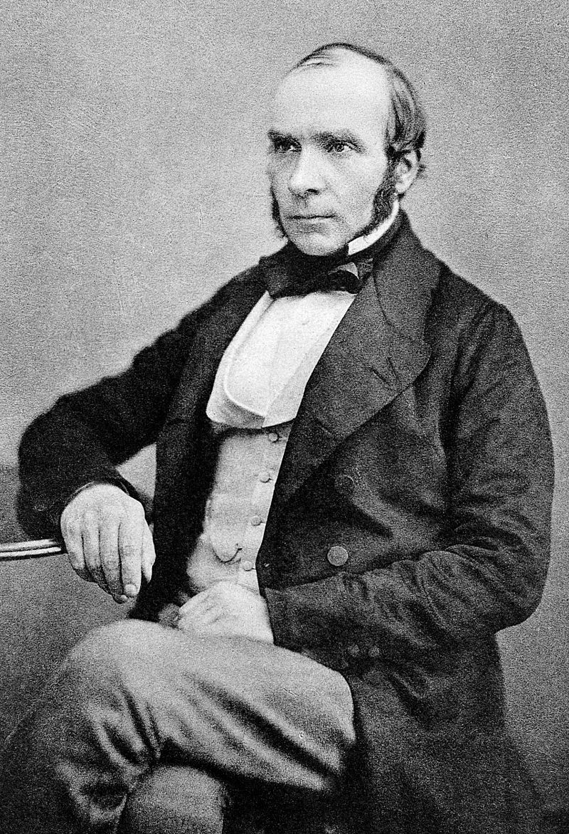
Dr. John Snow
Born: March 15, 1813 (York)
Died: June 16, 1858 (London)
Title: Founder of Epidemiology

Slide 4
Origins & Meeting Cholera
Humble Birth: Born in 1813 (York slums)
Apprenticeship: Newcastle (Age 14)
First Contact: Cholera Outbreak, 1831
Germ Theory: Only 1/20 doctors believed

Slide 5
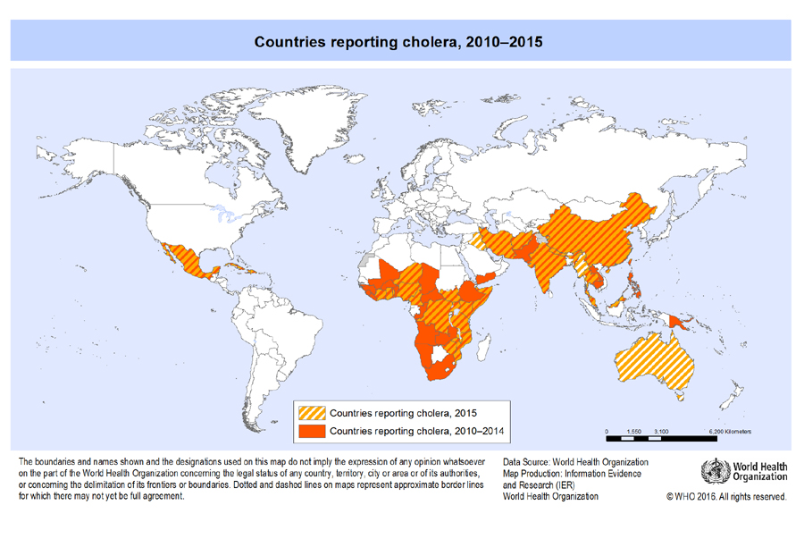
Cholera is terrifying.

Slide 6
Snow’s Education & Break from Cholera
1836, London University
1838, General Practitioner’s License
1838, Apothecary’s License
1838, Ph.D. in Medicine
Still 1838, Royal College of Surgeons
Revolutionized anesthesia and twice treated Queen
Began collecting data (1848 Cholera Outbreak, London)

Slide 7

Source: Extra Credits (2015). England: The Broad Street Pump. Retrieved 2019-02-23 from https://www.youtube.com/watch?v=TLpzHHbFrHY.

Slide 8



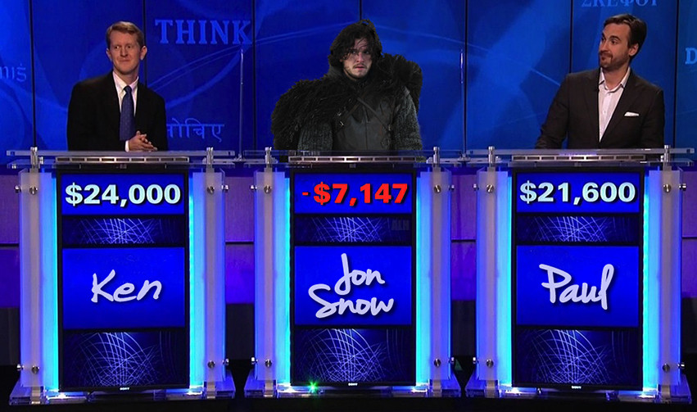




Slide 9
Cholera: More Evidence
Another Study: Water Companies
And Another Study: Thames River
“The Great Stink”
Tested water from tenants
Contaminated water had 4x amount of sodium
Didn’t have time to prepare his data…

Slide 10
“In Broad Street, on Monday evening, when the hearses came ‘round to remove the dead, the coffins were so numerous that they were put on top of the hearses as well as the inside.
Such a spectacle has not been witnessed in London since the time of the plague.”
- Newspaper (Tuesday, September 3, 1854)

Slide 11
Cholera: The Broad Street Pump
Cholera killed quickly
Collecting data was a race against time
Snow turned to government records
Developed one of the earliest, most important dot maps
Snow had his data visualization
Snow didn’t have the full story

Slide 12
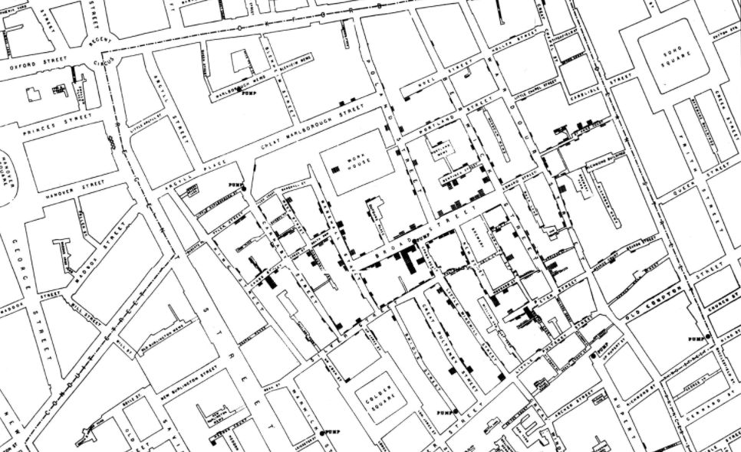

Slide 13
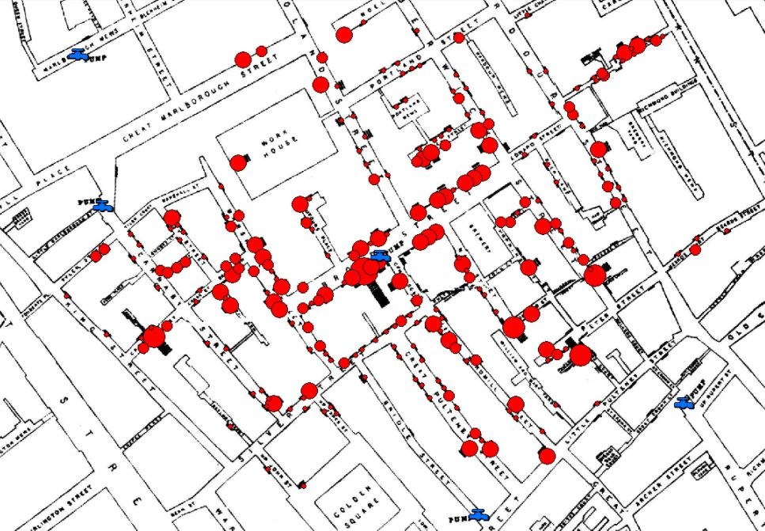
Source: Wilson, Robin (2013). “John Snow’s Cholera data in more formats”.

Slide 14
“I had an interview with the Board of Guardians of St James's parish, on the evening of the 7 September, and represented the above circumstances to them.
In consequence of what I said, the handle of the pump was removed on the following day.”
- Dr. John Snow

Slide 15
Snow’s Legacy
Founding event of Epidemiology
Sanitary Movement
Largest public works in recent history
New sewer systems (still used today)
Some cities entirely destroyed and rebuilt
London, alone:
13,000 miles of pipe (length of half of Earth)
318 million bricks
Chicago literally jacked up on stilts

Slide 16





Slide 17

Ben Wellington
Profession: Quantitative Analyst,
Visiting Professor (Pratt Institute)
Founder: “I Quant New York” (Blog)

Slide 18
New York City: Open Data
Before 2011, data required NYS FOIL requests
FOIL: Freedom of Information Law
2011, Mayor Bloomberg signed “Open Data Laws”
NYC Open Data Portal
1,200 + datasets

Slide 19
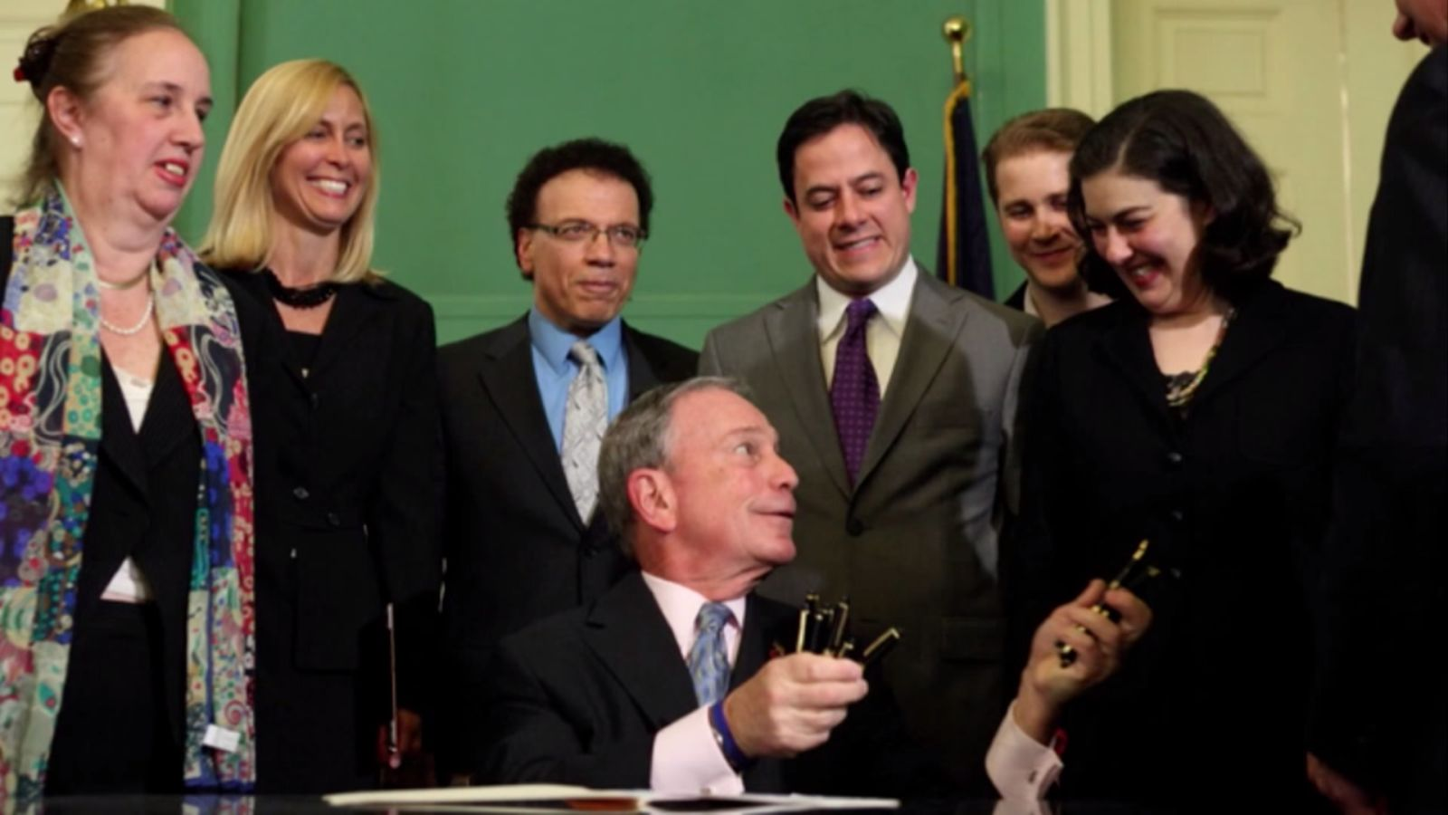

Slide 20
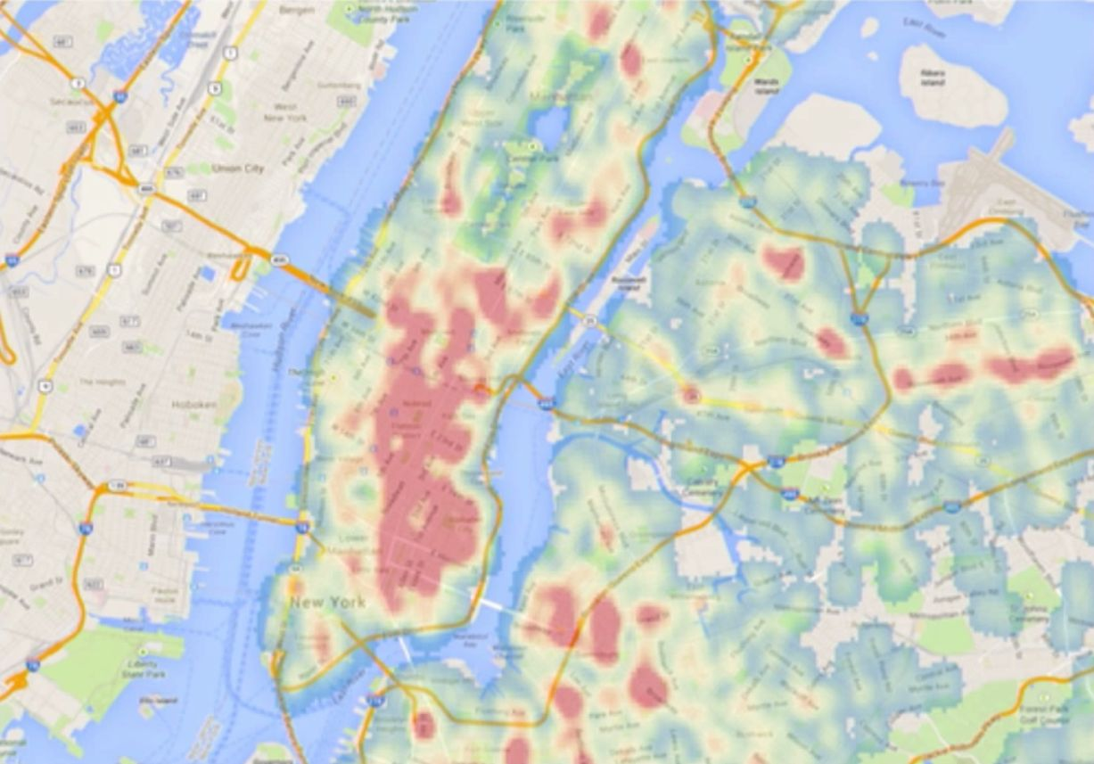
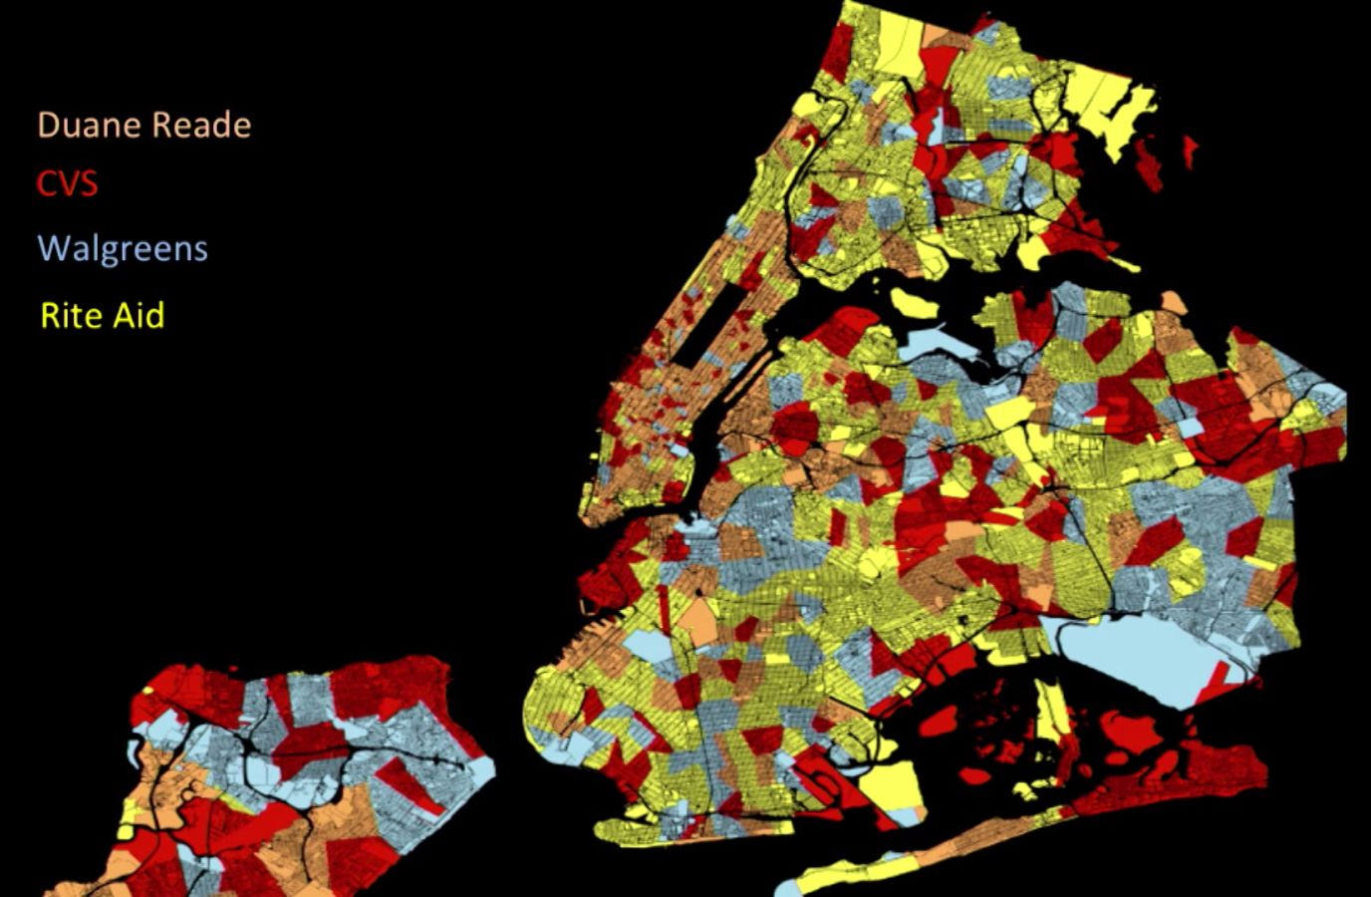
Wellington’s First Visualizations
Cycling Injuries
Pharmacy Preferences

Slide 21
Wellington’s “Story Triggering”
“I wrote about that and posted it on the blog. It was more for me to learn about mapping…
I posted it, and when I did, something interesting happened.
People started to write about it.”

Slide 22
Wellington’s Hydrants
Explored data on the most-ticked fire hydrants
Two “honey pots” in Lower East Side
Gross income of $55,000 / year:
$33,000 / year
$25,000 / year
And so he needed to develop his story…

Slide 23
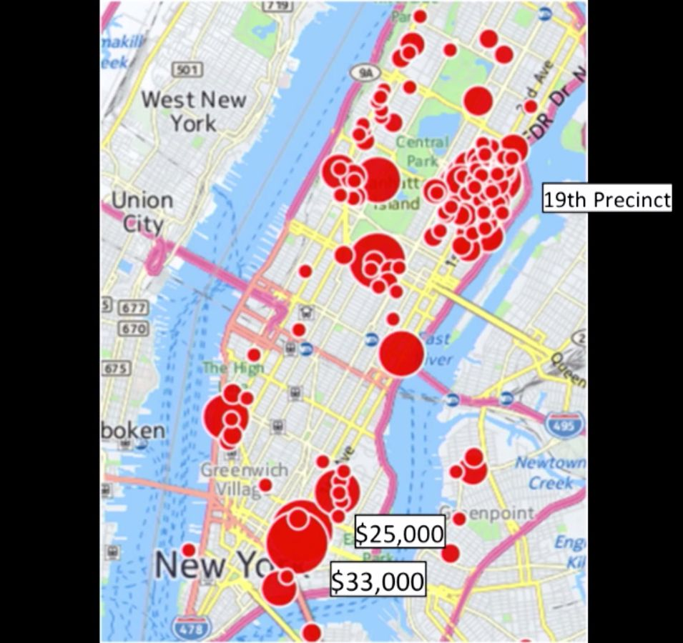

Slide 24
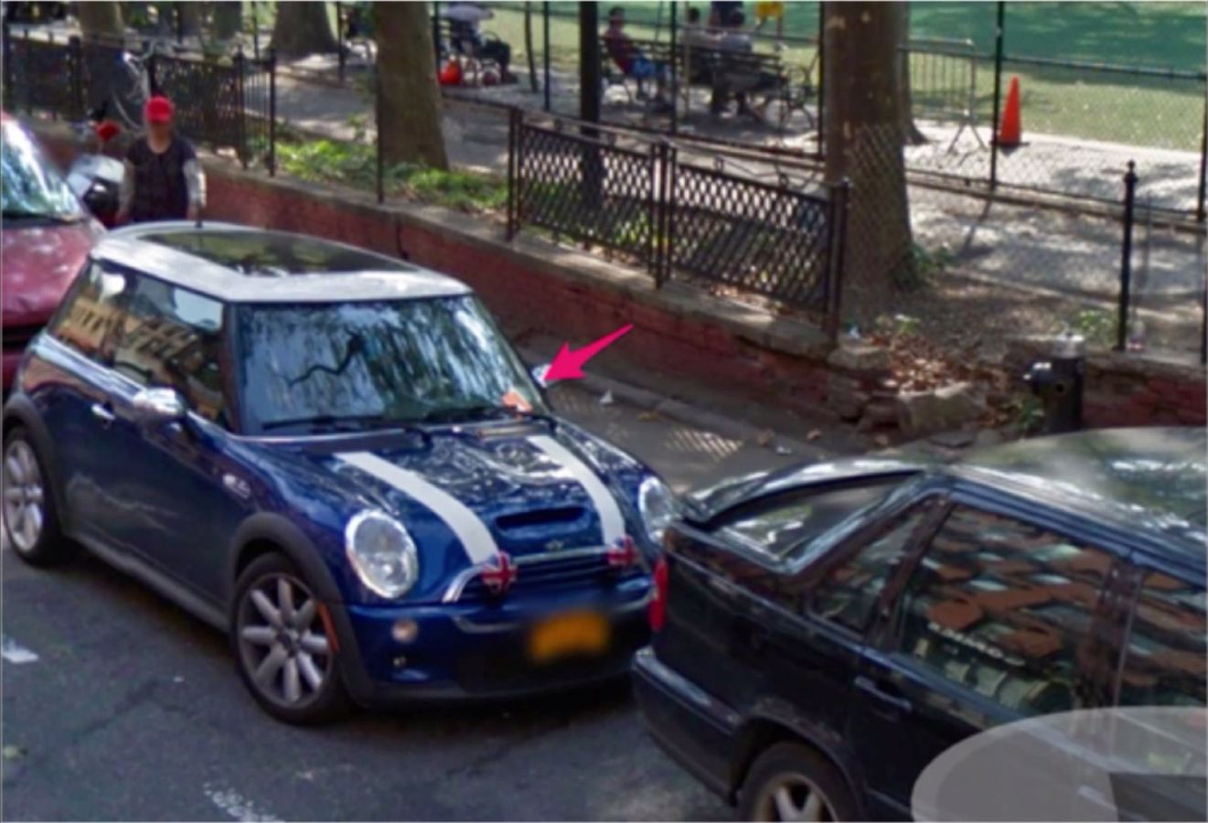

Slide 25
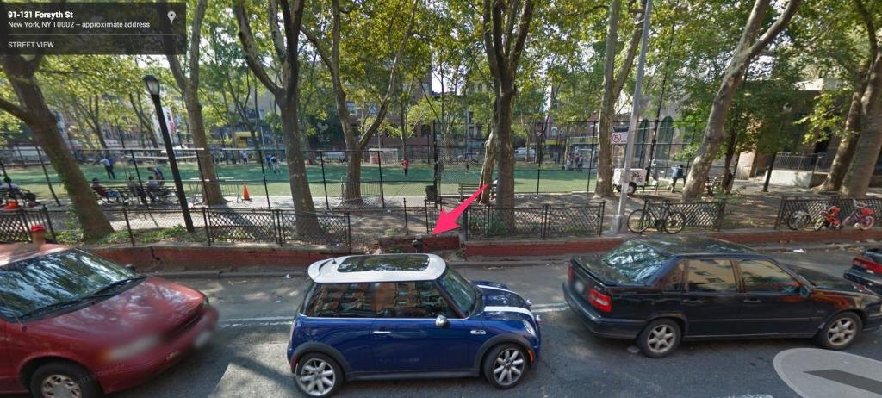

Slide 26
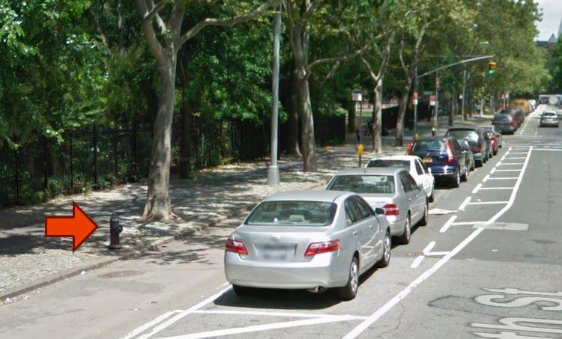

Slide 27
Public Response to Hydrants
Public outcry; infamous among data circles
Articles and articles on “Honey Pot” Hydrants
Department of Transportation:
“While DOT has not received any complaints about this location, we will review the roadway markings and make the appropriate alterations.”

Slide 28
“I thought to myself: ‘You know, typical government response’…
…moved on with my life.
But then, a few weeks later, something incredible happened…”
- Ben Wellington, TEDxNewYork

Slide 29
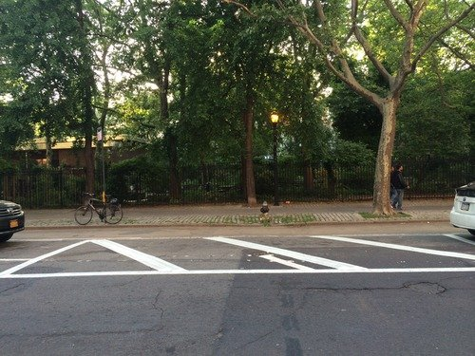
“…they repainted the spot.”

Slide 30
“…and for a second,
I thought I saw the future of open data.”

Slide 31
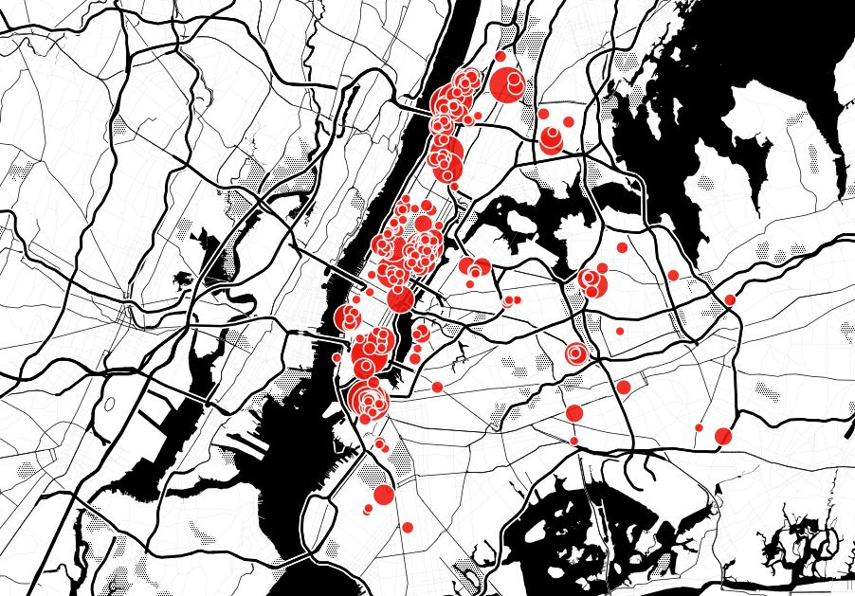

Slide 32
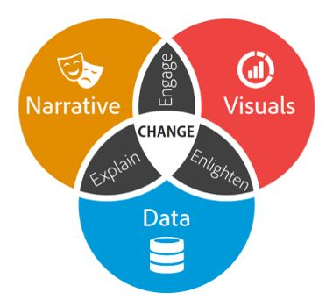
Why Were Snow & Wellington So Effective?
Robust, sound data
Strong, compelling narrative
Clean, intuitive visualization
Source: Dykes, Brent (2016). “Data Storytelling: The Essential Data Science Skill Everyone Needs”

Slide 33
The next two visualizations show the same data: Median Household Income by Family Size Syracuse, NY, 2016 Question: Which two family sizes have the highest median income?
Sources:
CNY Vitals Pro (2016). Median Household Income by Family Size.
US Census Bureau (2016). Table B19013: Median Household Income.

Slide 34
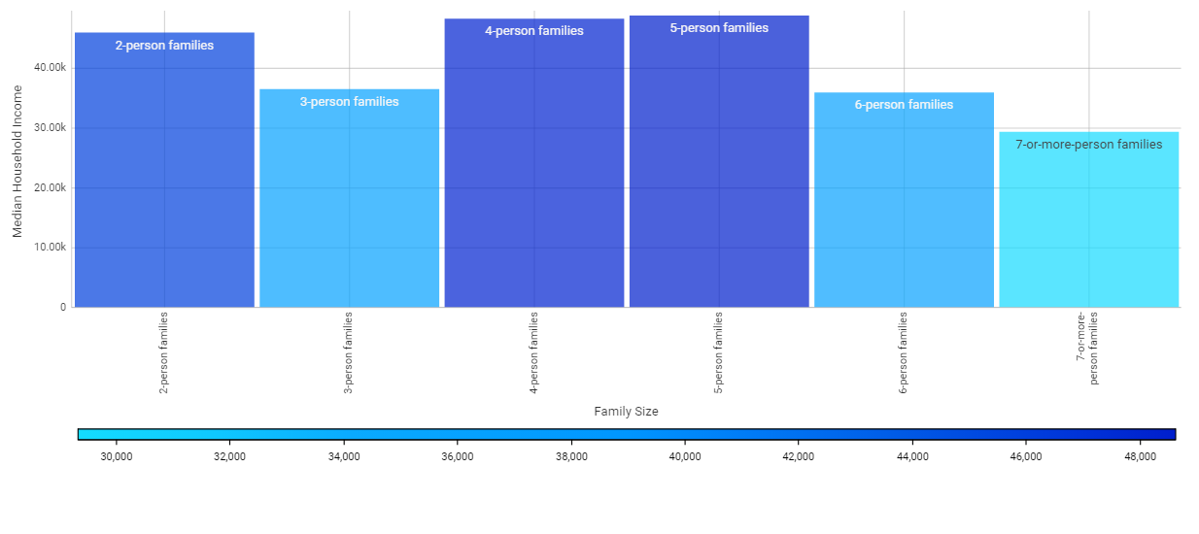

Slide 36
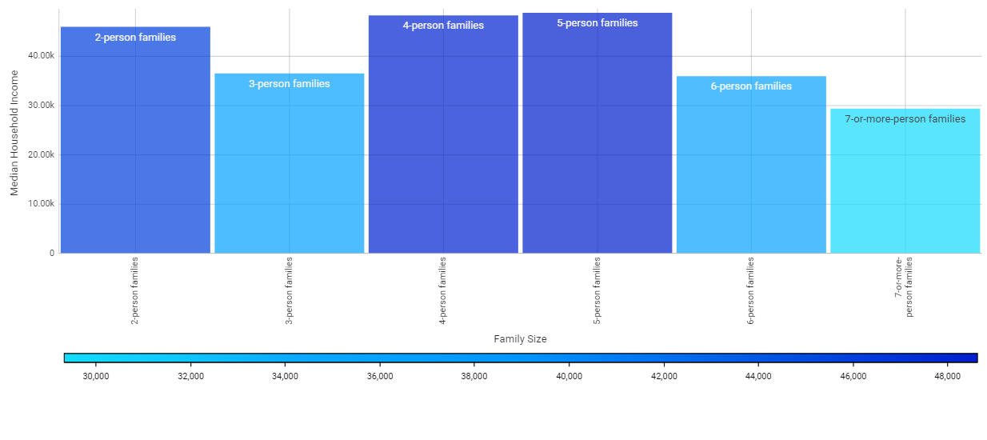
Two visualizations, same data.
Which chart most effectively communicates the data?

Slide 37
Law I You’re already an expert.

Slide 38
We’re Experts at Consuming Data Visualization
Data visualization is everywhere
We consume data visualization every day
We have preferences, but can’t always articulate
Grammar: Don’t know rules, we know what sounds right
Visualization: Don’t know rules, we know what looks good

Slide 39
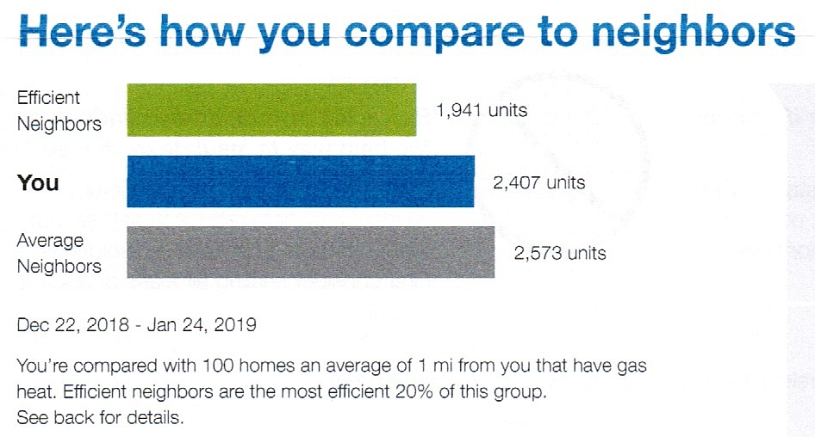
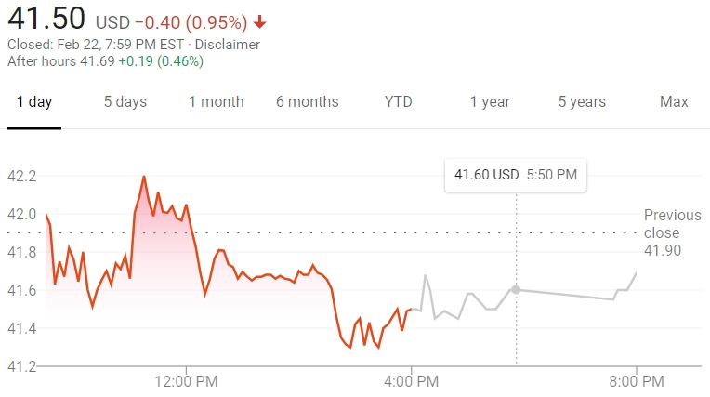
Utility Bills
Everyday Data Viz
Finance
Sources: National Grid (2019). Jamison’s Energy Bill. NASDAQ Market Summary (2019). Activision Blizzard.

Slide 40
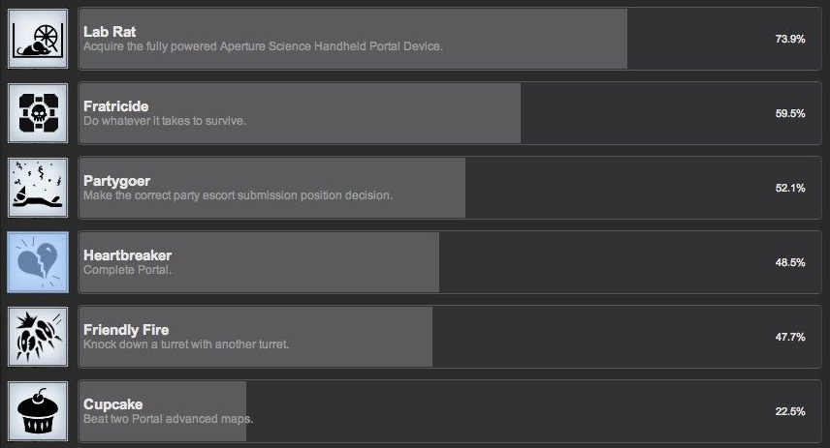
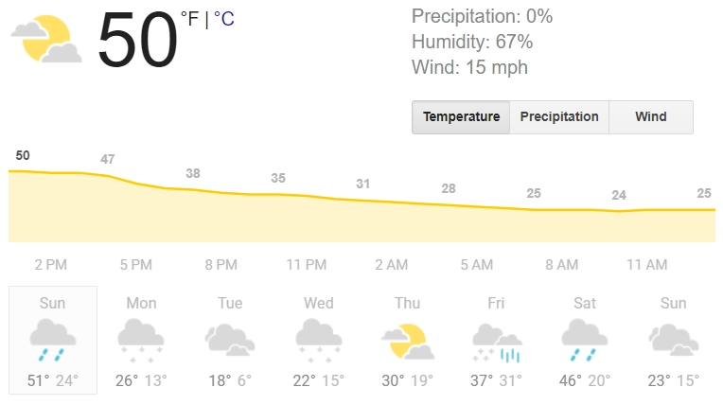
Gaming
Everyday Data Viz
Weather
Sources: Steam (2012). Individual Achievement Progress, Portal. Weather.com (2019). Weather for Syracuse, NY, 2019-02-24.

Slide 41
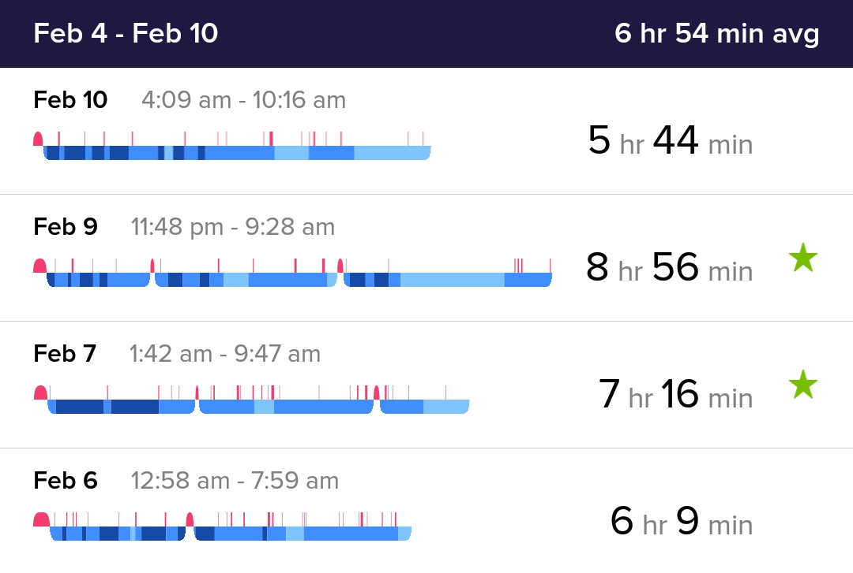
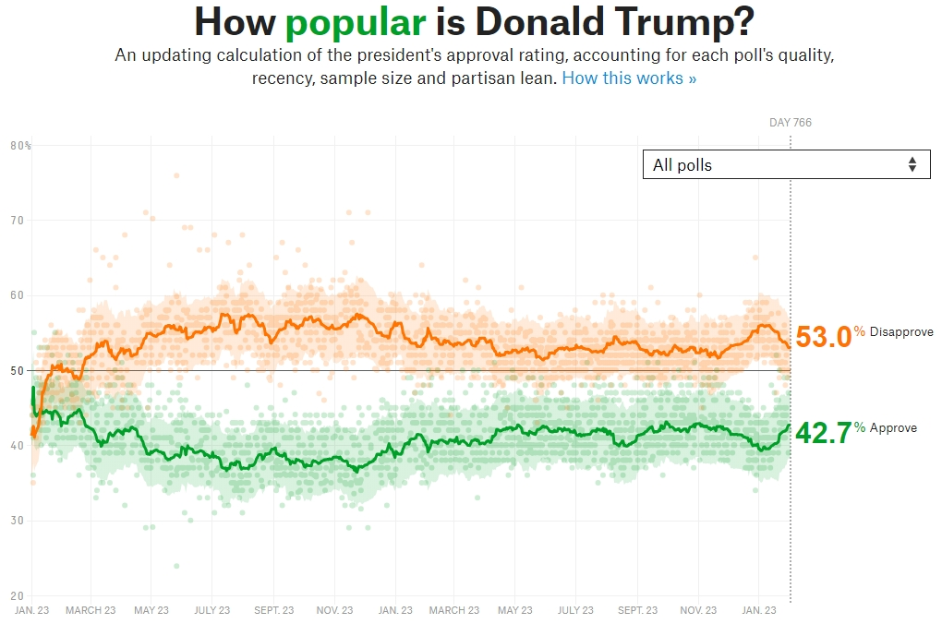
Wearable Tech
Everyday Data Viz
Politics
Sources: Fitbit App (2019). Sleeping Patterns. FiveThirtyEight (2019). How Popular is Donald Trump?

Slide 42
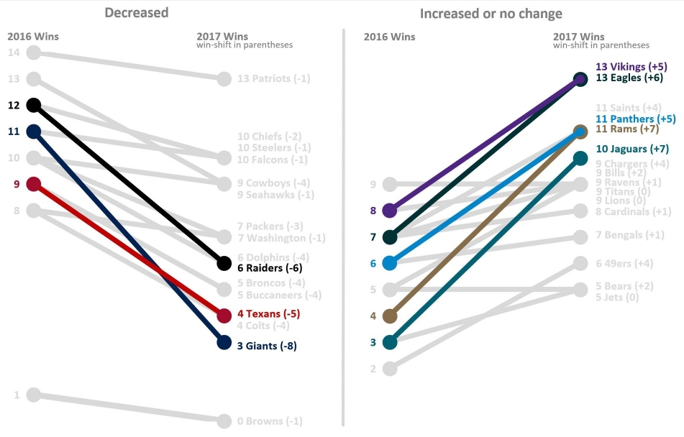
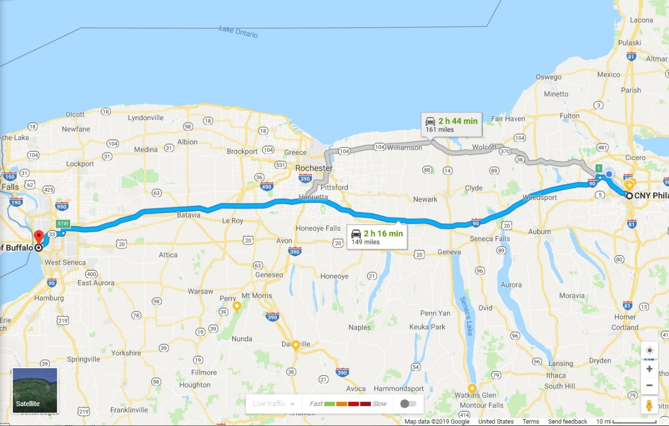
Sports
Everyday Data Viz
Travel
Sources: Pauley, Jason (2018). Shifting NFL Team W/L Records – Visualized. Google Maps (2019). Routes from Buffalo, NY to Syracuse, NY.

Slide 43
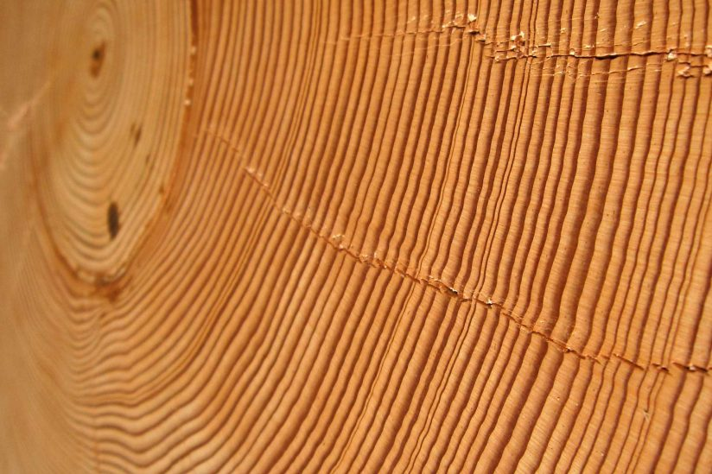
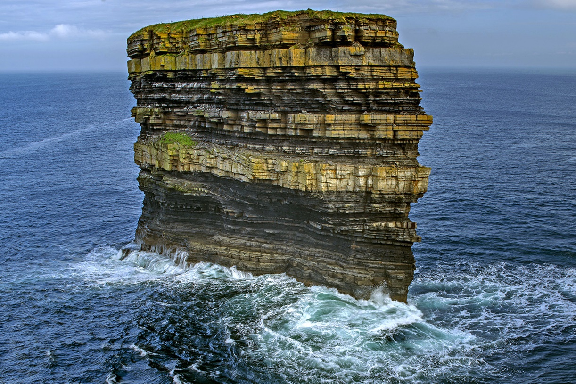
Tree Lifespan
Data Viz in Nature
Strata
Sources: Gersema, Emily (2017). Scientists have more data to back their findings: The Earth is getting warmer. Geggel, Laura (2018). That Sea Stack from Reddit Didn’t take ‘Millions of Years’ to Form.

Slide 44
We’ve had a lifetime of experience honing our visualization literacy.
Data visualization:
More widespread than ever
Democratized by cheap, easy-to-use tools
Resembles 1970-80s word processor boom
E.g. Electric Pencil, WordStar, WordPerfect, MacWrite
Visualization literacy is:
Expected

Slide 45
What is Data Visualization?
Definition: “The representation of an object, situation, or set of information as a chart or other image.”
Why Data Visualization?
Understanding: Explore data before analysis (Exploratory)
Communication: Publish findings after analysis (Explanatory)
Strategy: Provide form to the formless
Persuasion: Connect “statistical lives” to “identifiable lives”
Representation: A picture says a thousand data points
Sources: Oxford Living Dictionaries (2019). Data Visualization.

Slide 46
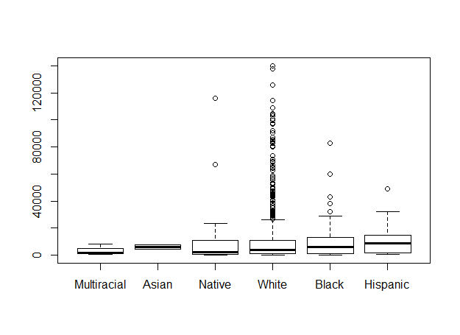
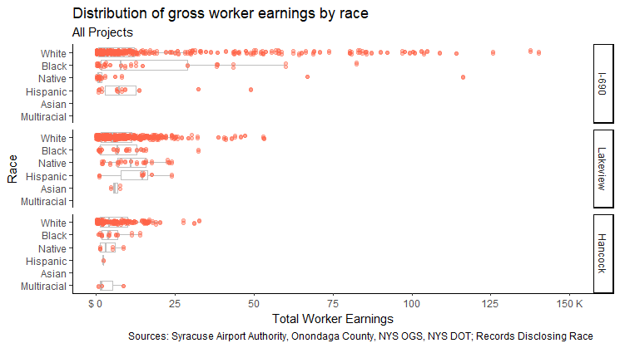
Exploratory vs. Explanatory Data Visualization
Exploratory:
Unpolished, “quick and dirty” plots and charts
Technique for exploring, learning, understanding data
Used internally by analysts and content experts
Explanatory:
Polished, publication-ready plots and charts
Intended to share with broad audience
Sources: Crawford, Jamison (2019). Distribution of gross worker earnings by race.

Slide 47
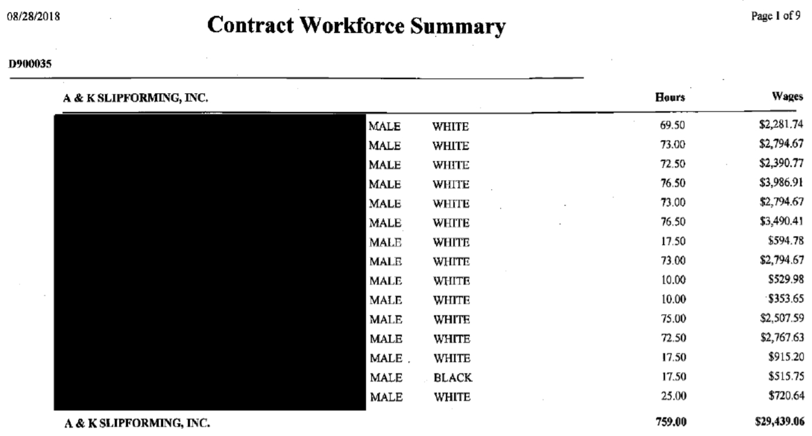
Exploratory Viz Interstate 690 Renovations in Syracuse, NY
Raw Data:
Workforce Summary, I-690
20 Contractors, 400 Workers
Variables:
Contractor
Worker gender, race
Total worker hours
Total worker earnings
Sources: Onondaga County (2018). Contract Workforce Summary, I-690.

Slide 48
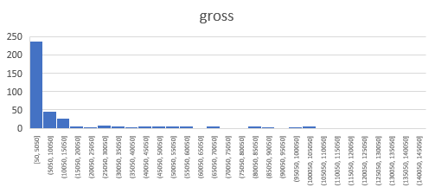
Exploratory Viz Interstate 690 Renovations in Syracuse, NY
Histograms: One Variable
Distributions
Peaks (“Modes”)
Concentration, Skew
Abnormalities, Outliers
Scatter Plots: Two Variables
Strength of relationship
Direction of relationship
Abnormalities, Outliers
Sources: Onondaga County (2018). Contract Workforce Summary, I-690.

Slide 49
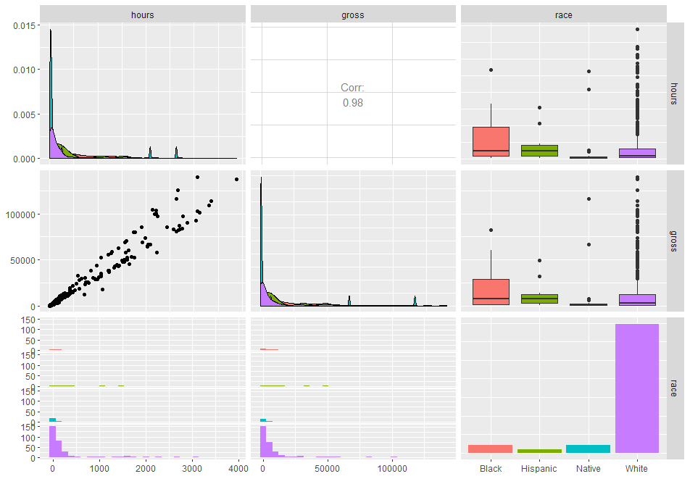
Exploratory Viz Interstate 690 Renovations in Syracuse, NY
Pairs Plots: All Variables
Automatic plot selection
Uses common scales
One line of code (R)
Sources: Onondaga County (2018). Contract Workforce Summary, I-690.

Slide 50
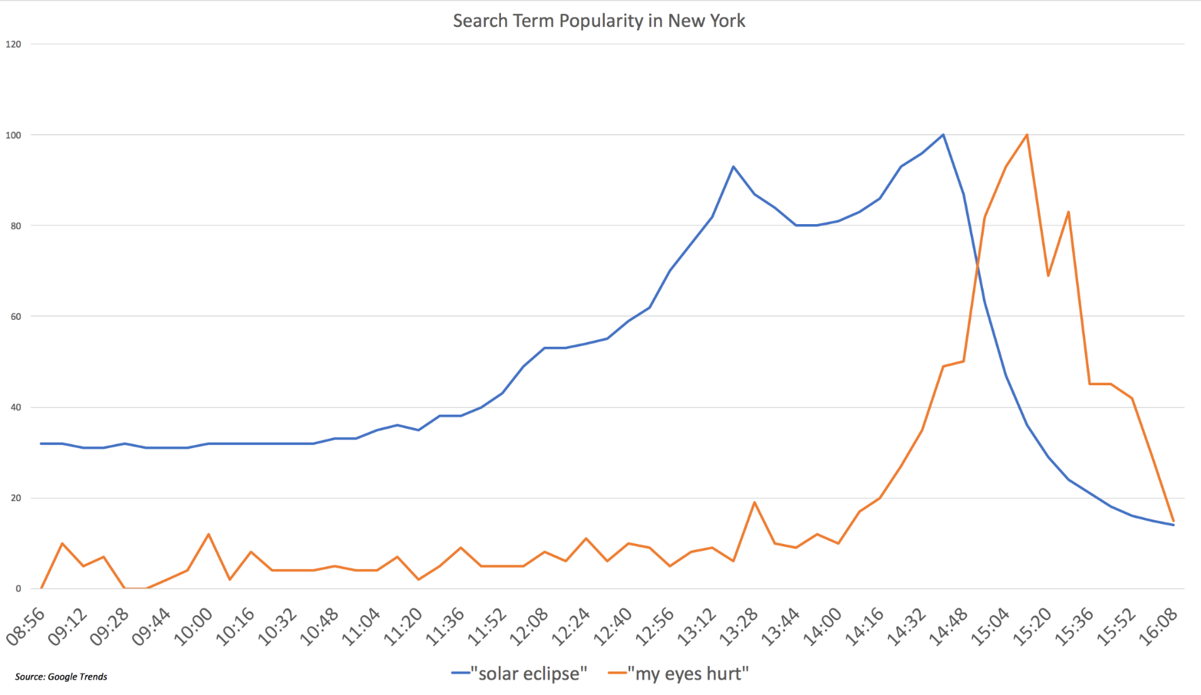
Exploratory Viz An Example “In the Wild”
Sources: User “superpaow”. Data is Beautiful. Reddit & Google Trends.

Slide 51
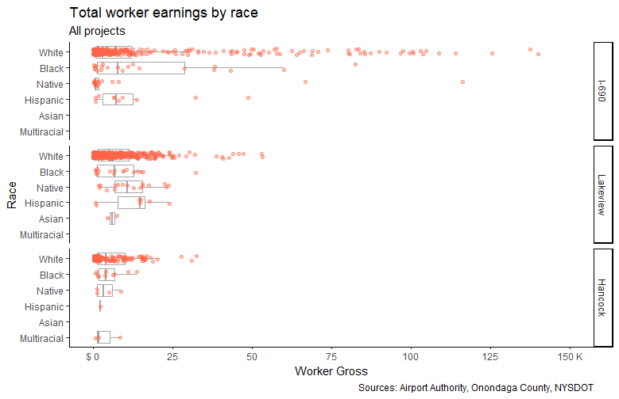
Explanatory Viz Interstate 690 Renovations in Syracuse, NY
Explanatory Visualization
Polished, publication-ready
Labelled appropriately
Limited non-data ink
Makes the data pop
For broad audiences
Sources: Crawford, Jamison (2019). Racial Equity Impact Statement Analysis.

Slide 52
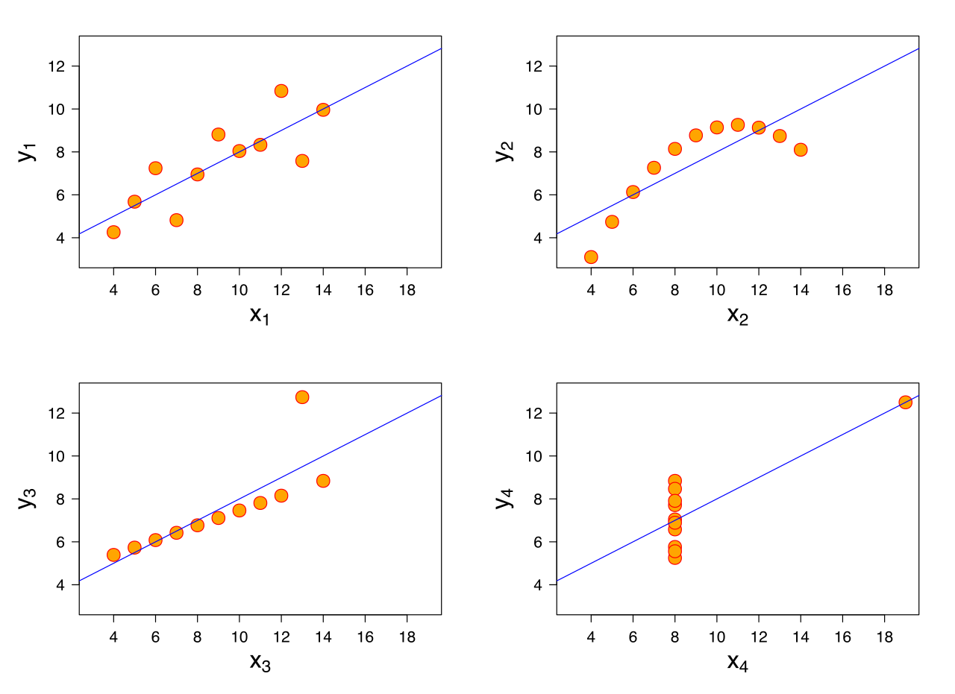
Why Exploratory Viz? Anscombe’s Quartet
Four unique datasets
Same average for X & Y
Same variance for X & Y
Same correlation (r)
Same linear regression
Same coefficients
Sources: Wikipedia (2019). Anscombe’s Quartet.

Slide 53
Law II You are always persuading.

Slide 54
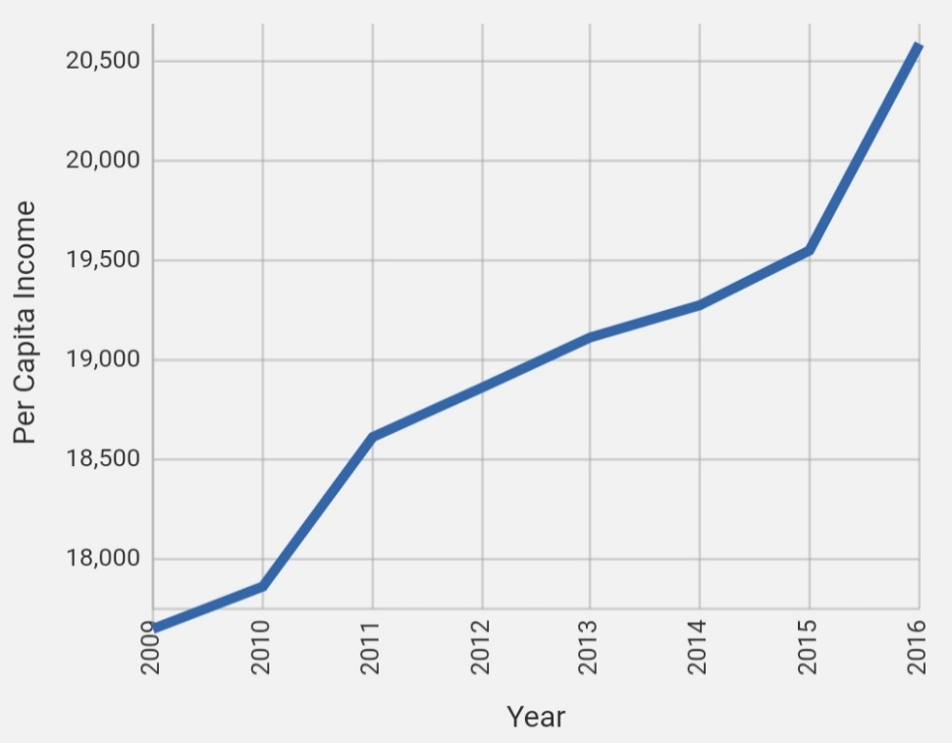
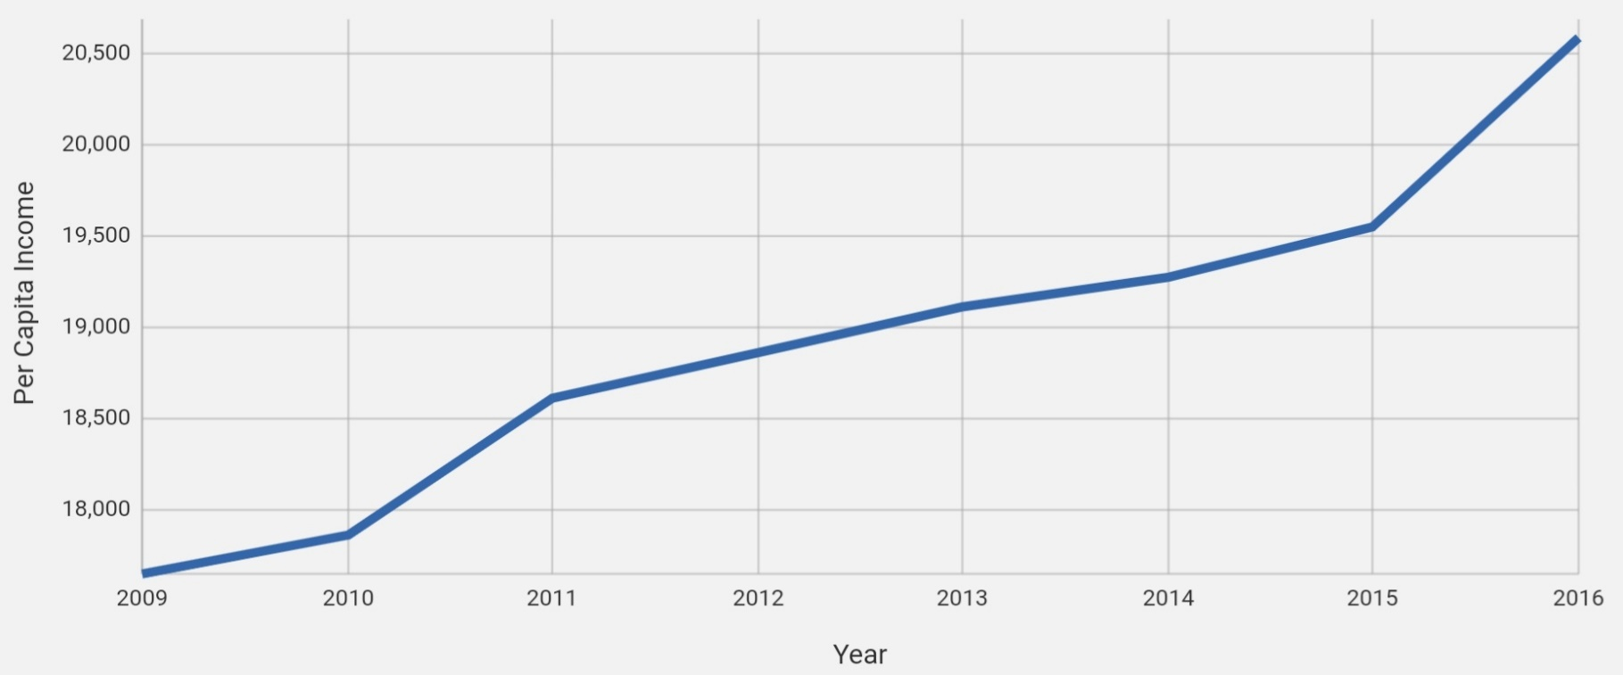
Which increase in income is more dramatic?
Increase A
Increase B
Sources: CNY Vitals Pro (2019). Per Capita Income in Syracuse, NY.

Slide 55
Neither, I just turned my phone sideways.
Portrait Orientation (Vertical)
Landscape Orientation (Horizontal)
Sources: CNY Vitals Pro (2019). Per Capita Income in Syracuse, NY.

Slide 56
No hard rules, just good intentions.
“Every chart is a manipulation.”
Design choices are subjective, discretionary
Visual elements necessarily have subtle cues
Example elements:
Color, fill, weight, labeling, transparency, angle, hatching, faceting, coordinate system, scales, angle, saturation, palette, geometry, motion, line type, etc.
Visual Dishonesty
May be deliberate or inadvertent
Sometimes inevitable, but may be mitigated
Source: Berinato, S. (2019). Good Charts.

Slide 57
Dishonesty: Truncated Y-Axes
Source: CNY Vitals Pro (2019). Per Capita Income Over Time, Syracuse, NY.

Slide 58
Dishonesty: Double Y-Axes
Source: Wikipedia (2019). Nicholas Cage Filmography. CNY Vitals Pro (2019). Per Capita Income Over Time, Syracuse, NY.

Slide 59
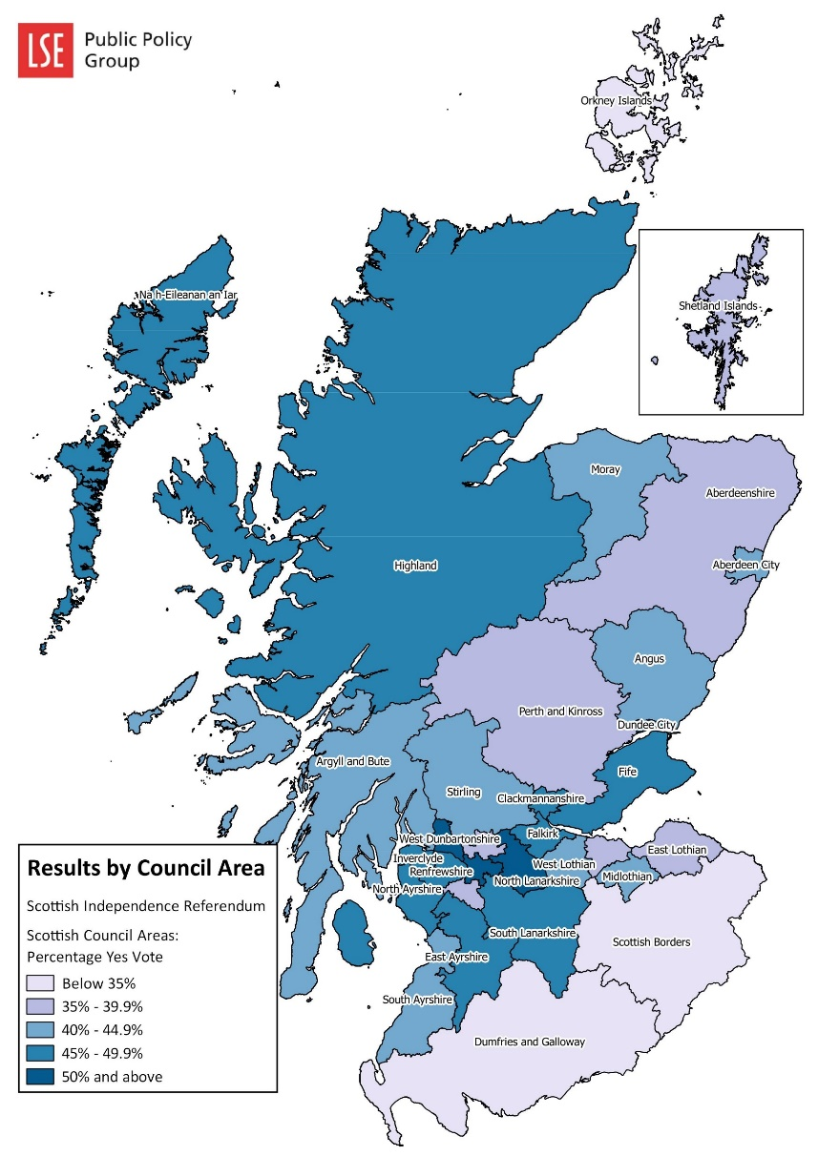
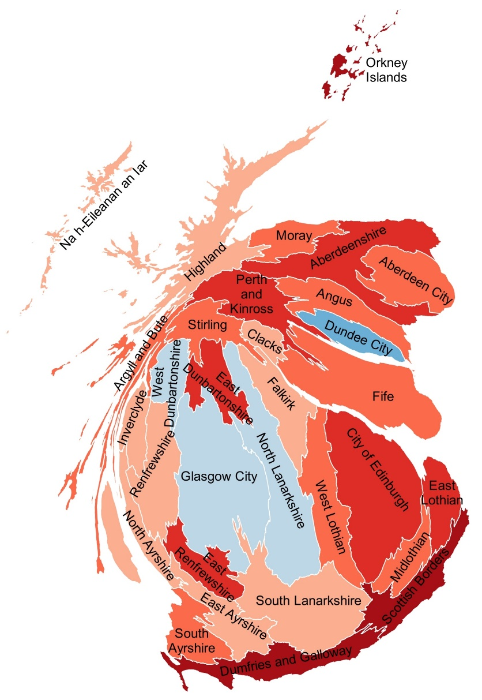
Dishonesty: Hidden Population Densities
Sources: LSE Policy Public Group (2014). Scottish Independence Referendum.
GIS for Thought (2014). Scottish Independence Referendum 2014 – Cartogram.

Slide 60
Dishonesty: Angles
The worst.
Still pretty awful.
Sources: CNY Vitals Pro (2019). Arts Grants, Syracuse, NY.

Slide 61
Visualize virtuously.

Slide 62
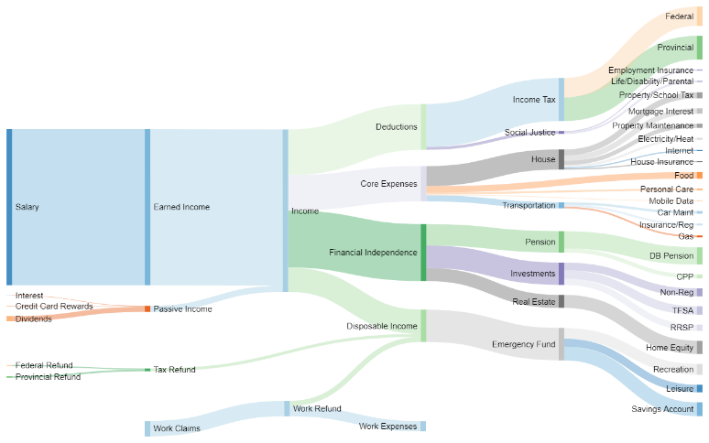
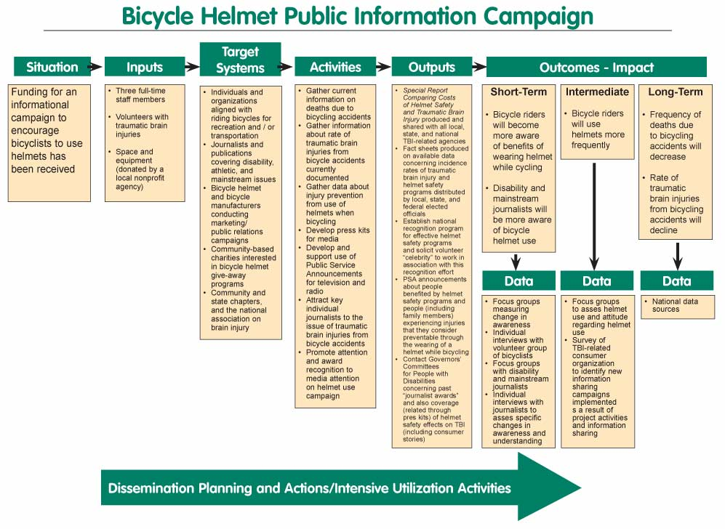
Data Visualization vs. Info Visualization
Data Visualization:
“Accurate visualizations of the real world.”
Updated dynamically using code
Data rich
Information Visualization:
“Visualization of concepts… abstract in nature.”
Updated manually using design software
Data poor
Sources: Nagel, Henrik R. (2006). Scientific visualization versus information visualization.
Canadian Money Forum (2018). Cash Flow Sankey Diagram.
Moss, Ian David (2012). In Defense of Logic Models.

Slide 63

Team Up to Persuade: Analysts & Web Developers
Narrative-Driven Visualizations:
Informs and persuades
Highly polished, user-friendly
Narrative-driven and/or exploratory
Combines data science, information architecture
Source: Metoomentum (2018). Trending Seeds.

Slide 64
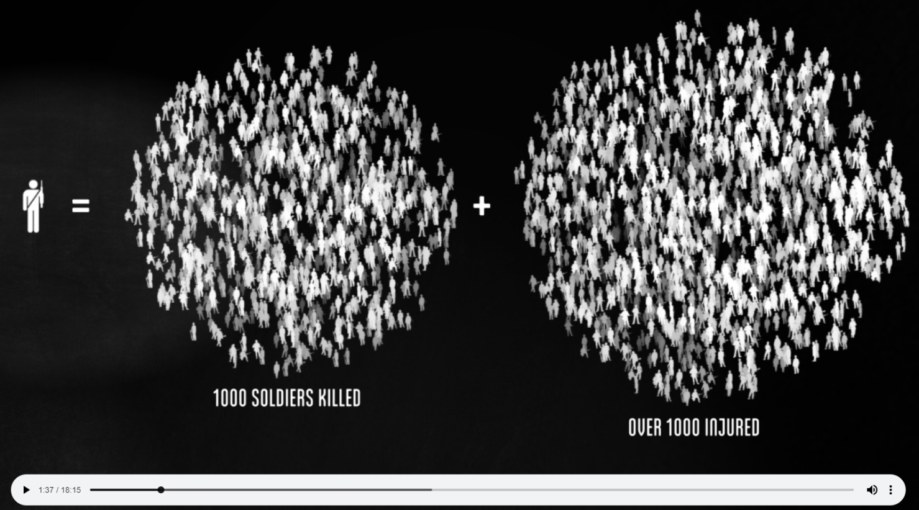
Team Up to Persuade: Analysts & Videographers
Cinematic Data Visualization:
Informs and persuades
Highly polished, user-friendly
Narrative-driven, less exploratory
Combines data science, videography
Source: Halloran, Neil (2015). The Fallen of World War II.

Slide 65
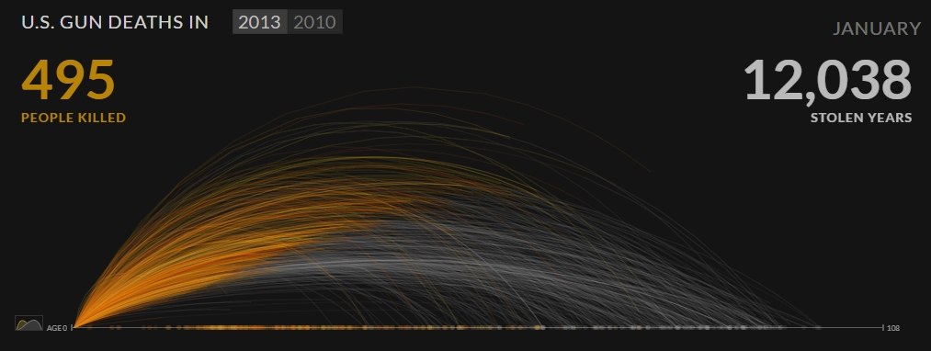
Team Up to Persuade: Analysts & Journalists
Data-Driven Reporting:
Informs and persuades
Highly polished
Narrative-driven
Combines data science, journalism
Source: Periscopic (2013). U.S. Gun Deaths in 2013.

Slide 66
Law III Respect your audience.

Slide 67
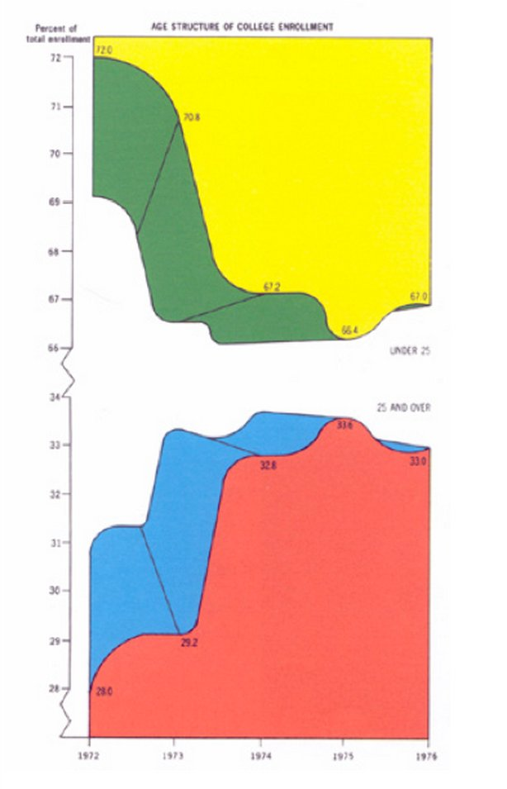
Disrespectful Viz: An Example
“Here five colors report, almost by happenstance, only 5 piece of data…
This may be the worst graphic ever to find its way to print.”
(Edward Tufte)
Source: Tufte, E. (2001). The Visual Display of Quantitative Information.

Slide 68
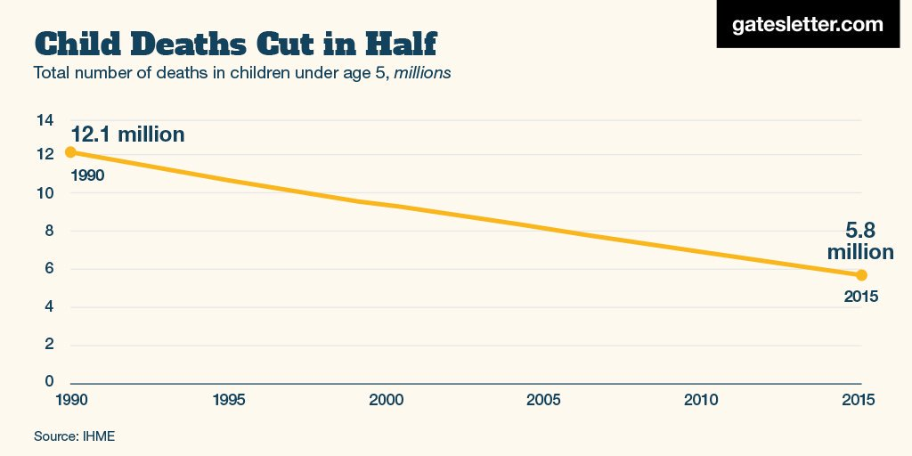
Disrespectful Viz: Another Example
“This is the most beautiful chart in the world.”
(Bill Gates)
Source: Gates, B. (2017). Child Deaths Cut in Half. Gates Letter.

Slide 69
Visualizing Respectfully
DO NOT:
Use inappropriate detail
Use unnecessary visualization
Diversify charts for diversity’s sake
Use superfluous color, lines, etc.
Ever get caught in a “gotchya”
Visualize to discuss a visual
DO:
Show an idea, not an attractive chart
Save high-detail data for appendix, handouts
Provide context (data, sources, background)
Spend time refining for clarity
Know your data enough
Visualize to discuss an idea

Slide 70
Respect Your Audience’s Time
The amount of time spent explaining a chart is directly proportional to the chart’s ability to communicate clearly.
What do we lose when we explain a chart?
Time.

Slide 71
Use the best “data ink”.

Slide 72
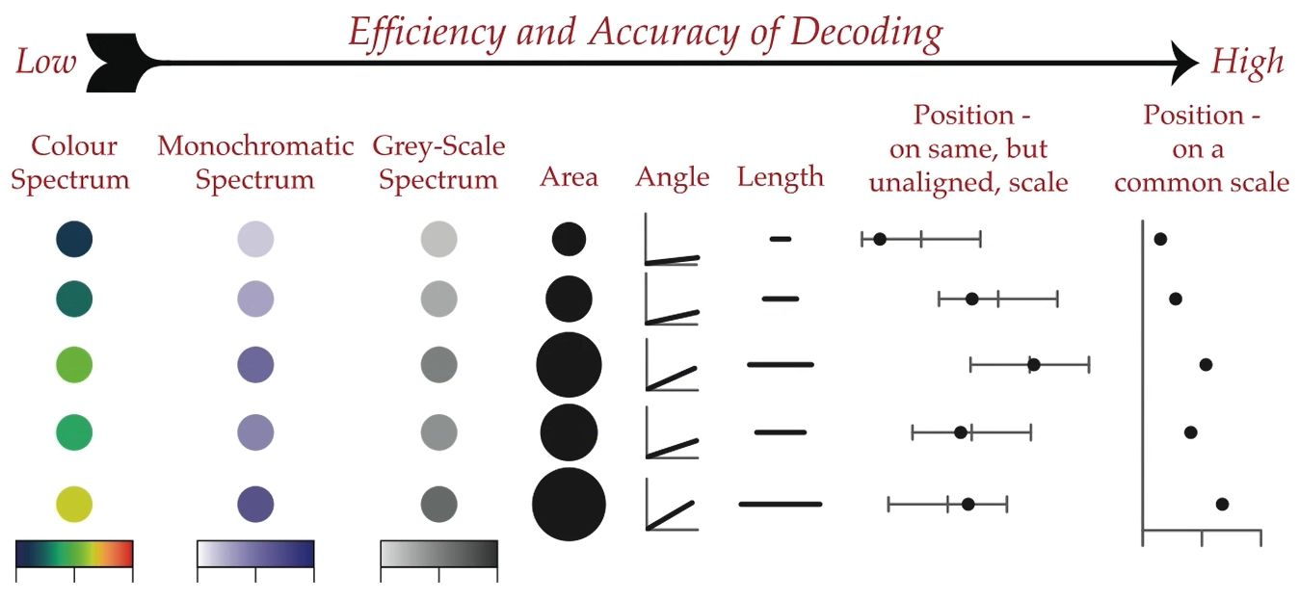
Efficient Data Ink: Continuous Values
Source: Scavetta, Rick (2020). Data Visualization with ggplot2. Adapted from Wong, B (2010).

Slide 73
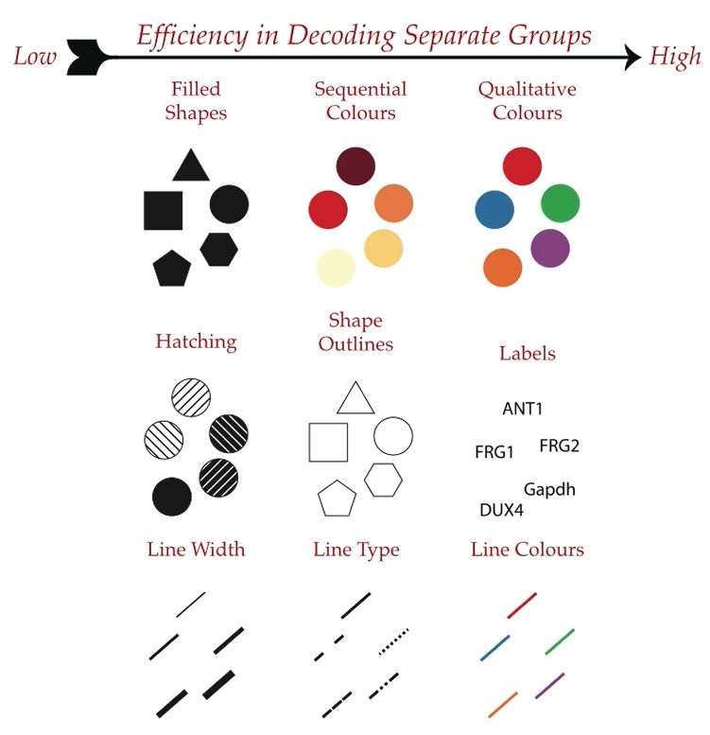
Efficient Data Ink: Categorical Values
Source: Scavetta, Rick (2020). Data Visualization with ggplot2. Adapted from Wong, B (2010).

Slide 74
Rely on conventions.

Slide 75
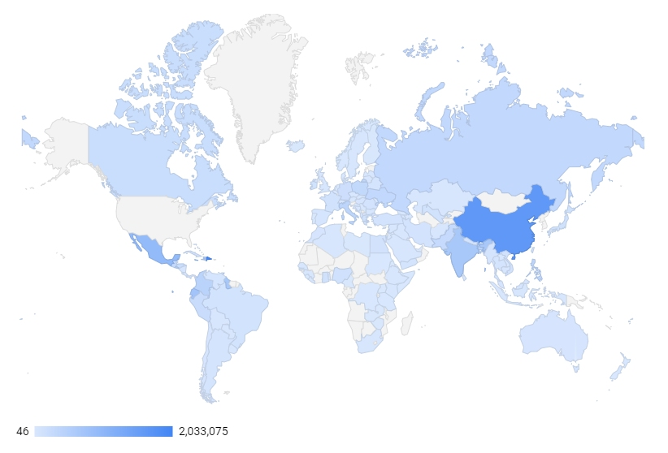
Conventions: Gradient Saturation Dark Means More

Slide 76
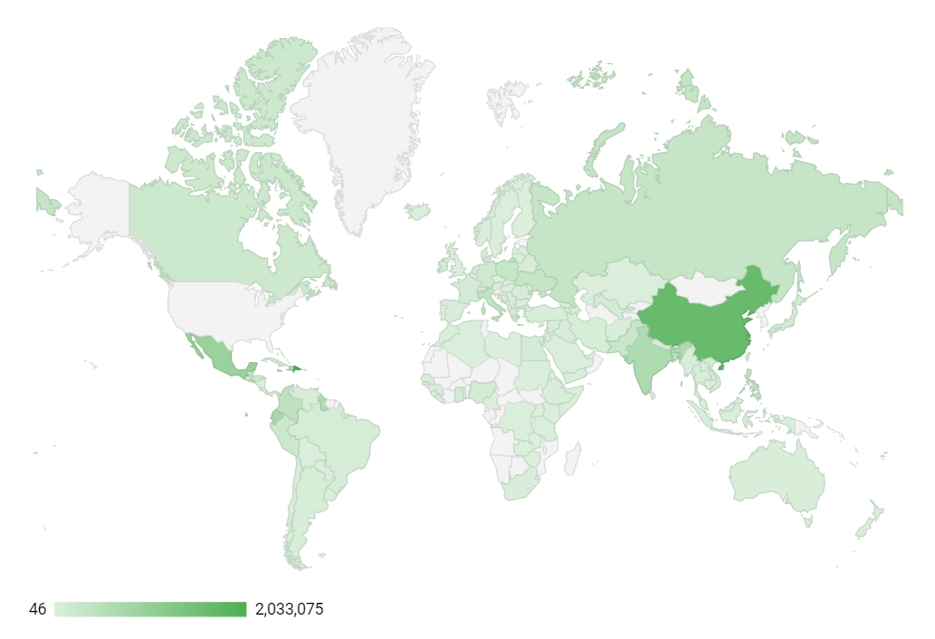
Conventions: Gradient Saturation The Tradeoff with Greens

Slide 77
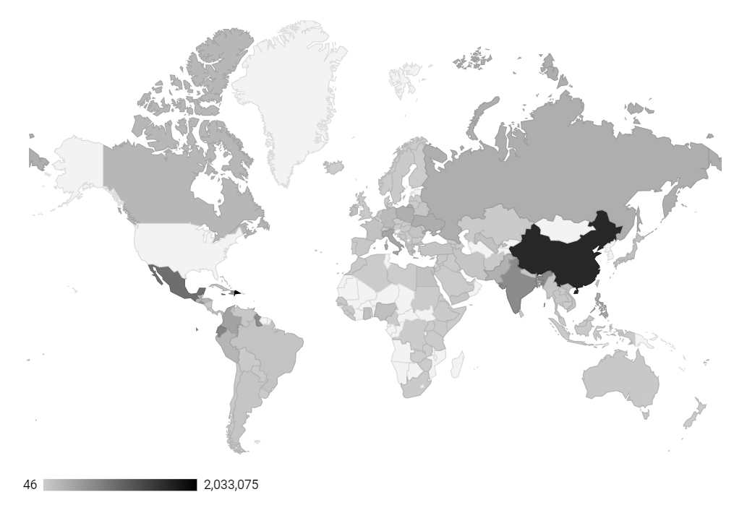
Conventions: Gradient Saturation You’ve Been Had! Color is Meaningless

Slide 78

Conventions: Divergent Colors Emphasizing & Color-Blind Friendly

Slide 79

Conventions: Divergent Colors Green Means Profit; Red Means Loss

Slide 80

Conventions: Discrete Colors Politicized Colors
Source: Silver, Nate (2018). “The 2018 Map Looked a Lot Like 2012”. FiveThirtyEight.

Slide 81
Limit eye movement.

Slide 82
Example: Autogenerated Column Chart (Excel)

Slide 83
Conventions: Limiting Eye Movement The Zig-Zag Pattern, Before

Slide 84
Conventions: Limiting Eye Movement The Zig-Zag Pattern, After

Slide 85
Conventions: Eliminate Redundancies Reduced Eye Movement

Slide 86
Lose the junk.
More signal; less noise.

Slide 87
Conventions: Eliminate Redundancies With Chart Junk

Slide 88
Conventions: Eliminate Redundancies With Chart Junk & Annotation

Slide 89
Conventions: Eliminate Redundancies Without Chart Junk

Slide 90
Take an extra 5-10 minutes to polish.
It’s out of respect.

Slide 91
Conventions: Draw the Eye Emphasize, Polish, Annotate, & Source
Purchased in 2009 in Entropia, triggering
the virtual real estate rush, Crystal Palace generates $52.4 K in annual revenue.
Source: The Richest “10 Most Expensive Virtual Items Ever Sold”

Slide 92
Summary
Law I: You’re already an expert. Law II: You are always persuading. Law III: Respect your audience.
Use the Best “Data Ink”
Rely on Conventions
Lose the Junk
Add Polish

Slide 93
Further Resources

Slide 94
Visualization Resources
Tooling: Visualization Tooling Guide (Berinato, 2016)
Selecting a Viz: Data Viz Project (Ferdio, 2019)
Matching Colors: Image Color Picker
Complementary Colors: Coolers (Bianchi, 2018)
Color & Accessibility: Contrast Checker (Web AIM, 2020)

Slide 95
Visualization Galleries
Good Visualization:
Data Is Beautiful (Reddit)
Information Is Beautiful
Google Data Studio Gallery
D3 Graph Gallery
Bad Visualization
Data Is Ugly (Reddit)
More, but inappropriate titles

Slide 96
Questions?

Slide 97
Contact Information & Thanks
Jamison Crawford, MPA
jcrawford52@gsu.edu
(404) 413-1404
Thank you!

